Slide 1
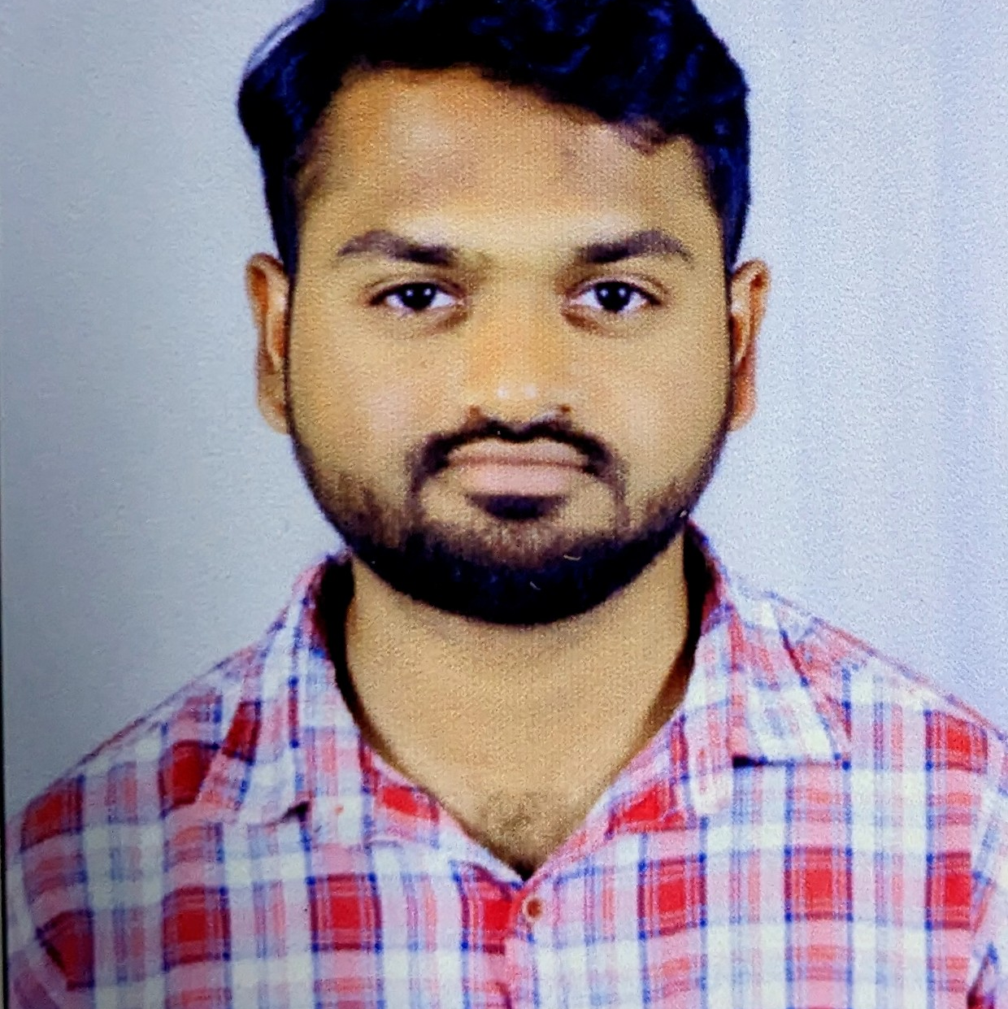



Mohammed Rayyan
Analyst/Software Engineer
Bachelor of Technology
Mechanical Engineering:
2018 - 2022
Skills
Navi Mumbai
Java 8 /J2EE | Java Basics, OOPS, Generics, Collections, Arrays, Loops, Lambda Exp, Stream API Junit, Mockito, Servlets
Spring core | IOC & Dependency Injection, Autowire
Spring REST | REST controllers, Implementation of GET, POST, PUT & DELETE, Bean Validation & Exception Handling, Testing Services, Controller & Repository layer
Spring Data JPA | Implement DAO layer using spring Data repositories, Transaction Management
Spring Boot Microservices | Spring Boot Starters, annotations, Messaging Service, Sync/Async comms, Swagger API documents
Spring Cloud | Eureka, Netflix Ribbon, Feign Client, Netflix Hystrix, Netflix Zuul & Config Server
React | Components, Hooks, Event handling, Redux, Reducers,
Database | MongoDB Atlas, My SQL RDS Basics, PostgreSql using Pg Admin
UI Tech | HTML 5 & CSS 3,JavaScript, Reusable templates, Optimized UI Designed
Tools | Git, Postman, Maven, IDE
Add On skills | Communications, Team management. Peer learning
mohammed.rayyan@capgemini.com
+917036544600
A4
Full Stack Developer
Hands on experience in creating microservices with Springboot, Spring Security, Spring Cloud API Gateway, Eureka server,load balancing.
Hands on experience in building web pages using Html, CSS, Bootstrap and working knowledge on ReactJS with react hooks,reactive forms,routing and Material UI
Experience in creating documentation with Java docs and swagger and in unit testing using Junit, Mockito
Development experience using Eclipse, intellij, VS Code, pgAdmin for postgress, postman API connection and MongoDB by Atlas
Online Railway Reservation System Application
Completed end to end case study of Online Railway Reservation System Application along with JWT authentication,Swagger documentation and payment integration with testing using Junit and mockito, responsive UI with Material UI and ReactJS used for user interface, MongoDB Atlas as Database
Check out my work on GitHub & Video Profile

